Slide 1
Standardized Admission Tests and Graduation
Two major exams in use today:
Scholastic Aptitude/Assessment Test (SAT)
American College Testing (ACT)
Imperfect but necessary assumptions:
Test Score (Independent Variable)
Graduation Rate (Dependent Variable)
Question to answer
How strong of a predictor is a student’s test performance on their likelihood of graduation?

Slide 2
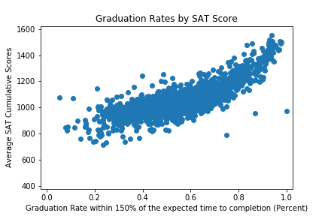
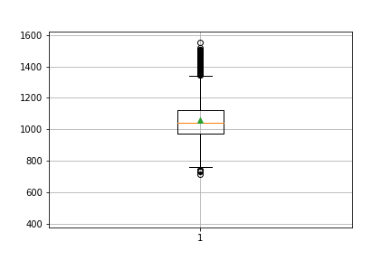
SAT Scores at a Glance
Scored from 400 to 1600
Traditionally been the more common requirement for schools on East and West coasts
Correlation of scores to graduation rate follows a parabolic curve
Limitations

Slide 3
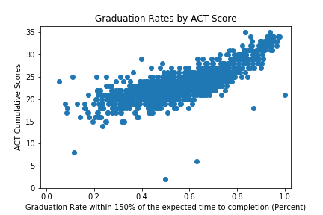
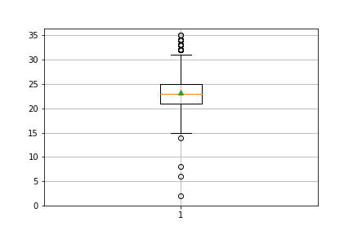
ACT Scores at a Glance
Scored from 1 to 36
Traditionally been the more common requirement for schools throughout the Midwest and South
Correlation of scores to graduation rate follows a more linear trend
Limitations
Addressing confounding variables, selectivity bias, and random error

